Slide 1
ATTENDANCE MONITORING SYSTEM USING RFID
VARUNESH 210701303
VINOTH N 210701311
THIRUESWARAN V 210701290

Slide 2
AGENDA
ABSTRACT
INTRODUCTION
OBJECTIVE
EXISTING SYSTEM
PROPOSED SYSTEM
MODULES
SYSTEM ARCHITECTURE
CONCLUSION AND FUTURE ENHANCEMENTS
REFERENCES

Slide 3
ABSTRACT
The primary aim of the project is to streamline attendance recording processes by implementing an RFID-based system.
This system utilizes RFID technology to accurately track attendance, reducing manual efforts and ensuring efficiency in large-scale operations.
Through a combination of RFID readers, tags, and a centralized database, the system automates attendance management, enhancing accuracy and reliability.

Slide 4
INTRODUCTION
Introducing an innovative solution for attendance management, the RFID-based system revolutionizes traditional recording methods. With RFID technology at its core, this system offers a streamlined approach to attendance tracking, eliminating manual processes and enhancing accuracy. The traditional methods of attendance tracking, like paper sign-in sheets or manual roll calls, are becoming increasingly outdated. While RFID attendance systems offer a significant leap forward, advancements in technology are paving the way for even more sophisticated solutions..Designed to cater to various settings, it promises to optimize efficiency and alleviate the burden of attendance monitoring for organizations and individuals alike.

Slide 5
OBJECTIVE
Implement RFID technology to streamline attendance tracking.
Automate attendance recording to reduce manual efforts.
Enhance accuracy and reliability of attendance data.
Provide a user-friendly interface for efficient management.
Improve overall attendance monitoring processes.

Slide 6
MOTIVATION
In environments where attendance tracking is crucial, such as educational institutions, workplaces, and events, manual methods often prove time-consuming and error-prone. This reliance on manual processes can lead to inaccuracies, inefficiencies, and even fraudulent activities like buddy punching. Moreover, the lack of real-time data accessibility hampers decision-making and resource allocation. Recognizing these challenges, we were driven to develop an automated attendance system leveraging RFID technology.

Slide 7
KEY CHALLENGES
Weight and Size.
Scalability and Capacity.
Dust and Environmental Factors.
Propelling Efficiency.
Integration with Controlled Devices.

Slide 8
EXISTING SYSTEM
The current attendance tracking methods predominantly rely on manual processes, such as paper-based sign-in sheets or manual data entry into digital systems.
This manual approach is time-consuming, prone to errors, and lacks real-time data accessibility.
Additionally, it requires significant human effort for attendance recording and management, leading to potential inefficiencies and increased administrative burden.

Slide 9
PROPOSED SOLUTION
Our proposed solution involves the implementation of an RFID-based attendance system, leveraging advanced technology to streamline attendance tracking and management.
Utilizing RFID tags and readers, the system will enable automated attendance recording, eliminating the need for manual processes.
A centralized database will store attendance data in real-time, providing instant access to authorized personnel.
This solution promises increased accuracy, efficiency, and security in attendance monitoring across various settings, including educational institutions, workplaces, and events.

Slide 10
MODULES
RFID Reader Module
RFID Tag Module
Green LED
Buzzer
Red LED
Arduino UNO
Serial Monitoring
Excel Monitoring

Slide 11
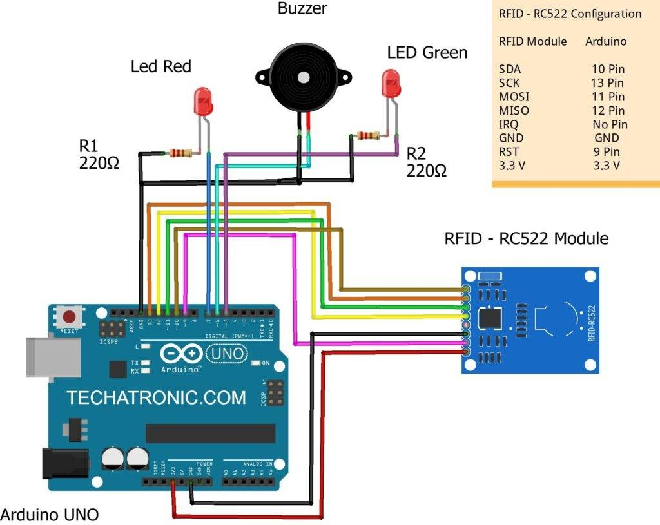
SYSTEM ARCHITECTURE

Slide 12
CONCLUSION
In conclusion, our RFID-based attendance system offers a comprehensive solution to the challenges posed by traditional attendance tracking methods. With complete automation achieved, our system not only ensures accuracy and efficiency but also enhances portability, making it suitable for diverse environments such as educational institutions, workplaces, and events. By promoting regular and reliable attendance monitoring, our system contributes to the creation of hygienic and productive environments while alleviating the burden on personnel responsible for attendance management.

Slide 13
FUTURE ENHANCEMENTS
Biometric authentication: Combine RFID with fingerprint or facial recognition for an extra layer of security, preventing "buddy punching" where someone else taps in for another person.
Mobile app integration: Allow employees to view their attendance records, request leave, and get notifications directly through a mobile app.
AI-powered features: AI can analyze data to detect unusual attendance patterns, flag potential issues, and even predict future absences.

Slide 14
THANK YOU

